Slide 1


Before Spring Boot

Slide 2

Spring Boot

Slide 3
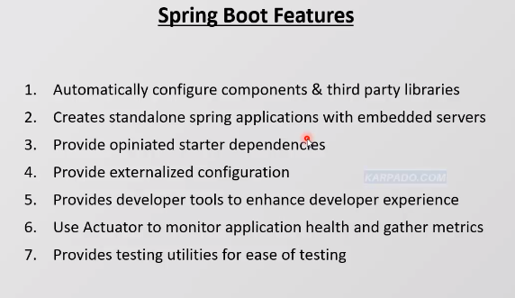
Before Spring Boot

